Slide 1
Lung Cancer Detection Using Machine Learning
Presented by: Alok Kumar
Batch: 4

Slide 2
Introduction
Lung cancer is one of the leading causes of cancer-related deaths worldwide.
Early detection significantly improves survival rates.
Machine Learning (ML) helps detect lung cancer quickly and accurately by analyzing patient data and medical images.

Slide 3
Objectives
Understand the role of Machine Learning in lung cancer detection.
Learn the workflow of an ML project.
Implement a lung cancer detection model using Python.
Evaluate the model's performance.

Slide 4
What is Machine Learning?
Machine Learning is a branch of Artificial Intelligence that enables computers to learn patterns from data without being explicitly programmed.
Types of ML:
Supervised Learning
Unsupervised Learning
Reinforcement Learning
For lung cancer detection, Supervised Learning is commonly used.

Slide 5
Dataset
Common datasets:
Lung Cancer Dataset (UCI Repository)
Kaggle Lung Cancer Dataset
CT Scan Image Dataset (LIDC-IDRI)
Features
Age
Smoking habit
Yellow fingers
Anxiety
Chronic disease
Wheezing
Chest pain
Fatigue
Target: Lung Cancer (Yes/No)

Slide 6
Machine Learning Workflow
Data Collection
Data Preprocessing Feature Selection
Train-Test Split
Model Training
Prediction
Evaluation

Slide 7
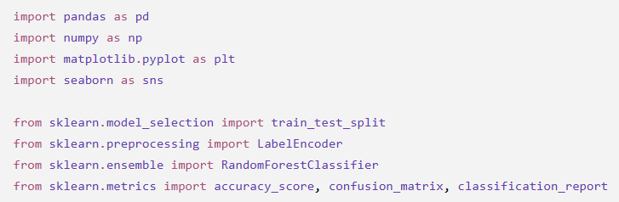
Python Libraries

Slide 8
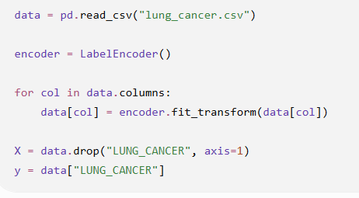
Data Preprocessing

Slide 9
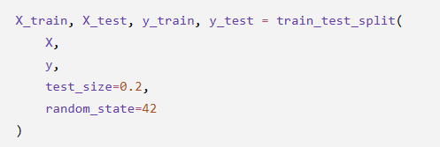
Splitting the Dataset
Training Data = 80%
Testing Data = 20%

Slide 10

Model Training Random Forest Classifier
Other algorithms:
Logistic Regression
Decision Tree
Support Vector Machine (SVM)
K-Nearest Neighbors (KNN)
XGBoost

Slide 11

Prediction
The trained model predicts whether the patient has lung cancer.

Slide 12
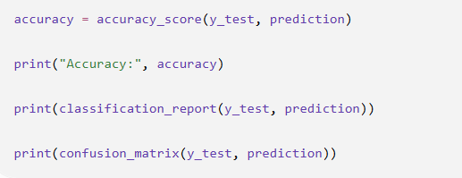
Model Evaluation
Evaluation Metrics
Accuracy
Precision
Recall
F1 Score
Confusion Matrix

Slide 13
Expected Output
Accuracy = 96%
Precision = 95%
Recall = 97%
F1 Score = 96%
Actual values depend on the dataset used.

Slide 14
Advantages
Early diagnosis
Faster decision making
Reduces human error
Cost-effective
Supports doctors in diagnosis
High prediction accuracy

Slide 15
Limitations
Requires quality data
Prediction depends on dataset size
Cannot replace medical professionals
Risk of overfitting with small datasets
Privacy and ethical concerns

Slide 16
Future Scope
Deep Learning using CNNs for CT scan analysis.
Integration with IoT healthcare devices.
Cloud-based diagnostic systems.
Explainable AI (XAI) for transparent predictions.
Real-time hospital decision support systems.

Slide 17
Conclusion
Machine Learning can significantly assist in the early detection of lung cancer.
Python provides powerful libraries for implementing ML models efficiently.
Random Forest and other supervised learning algorithms can achieve high accuracy when trained on quality datasets.
ML should be used as a decision-support tool alongside clinical expertise.

Slide 18
References
Python Documentation – https://www.python.org
Scikit-learn Documentation – https://scikit-learn.org
Kaggle Lung Cancer Datasets – https://www.kaggle.com
UCI Machine Learning Repository – https://archive.ics.uci.edu
World Health Organization (WHO) – https://www.who.int

Slide 19
Thank You

